Slide 1
Image Enhancement (Point Processing)
Dr Muhammad Zubair
1

Slide 2
Contents
In this lecture we will look at image enhancement point processing techniques:
Connectivity & Relationship b/w Pixels
What is Image Processing
What is point processing?
Negative images
Thresholding
Logarithmic transformation
Power law transforms
Grey level slicing
Bit plane slicing
Notes:
2

Slide 3
What is Image Enhancement
Process an image to make the result more suitable than the original image for a specific application
–Image enhancement is subjective (problem /application oriented)
Image enhancement methods:
Spatial domain: Direct manipulation of pixel in an image (on the image plane)
Frequency domain: Processing the image based on modifying the Fourier transform of an image
Many techniques are based on various combinations of methods from these two categories
3

Slide 4
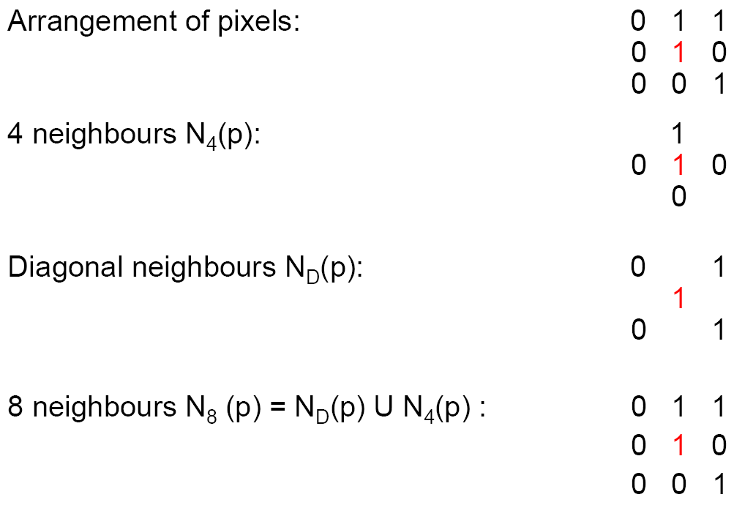
Relationship Between Pixels

Slide 5
Connectivity
Establishing boundaries of objects and components of regions in an image.
Group the same region by assumption that the pixels being the same color or equal intensity will have the same region
Two pixels may be four neighbors, but they are said to be connected only if they have the same value (gray level)

Slide 6
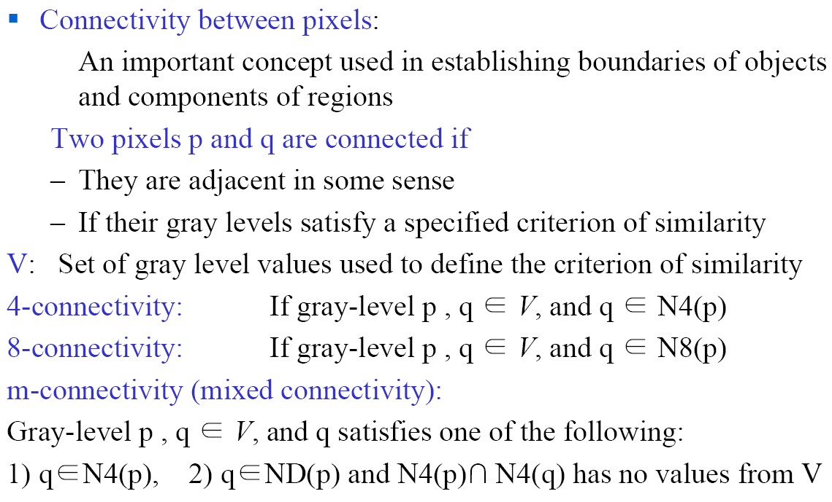
Basic Relationship b/w Pixels
6

Slide 7
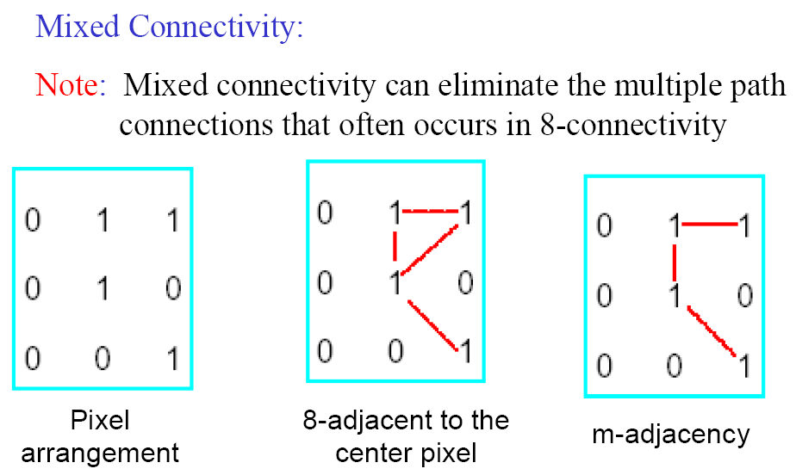
Basic Relationship b/w Pixels
7

Slide 8
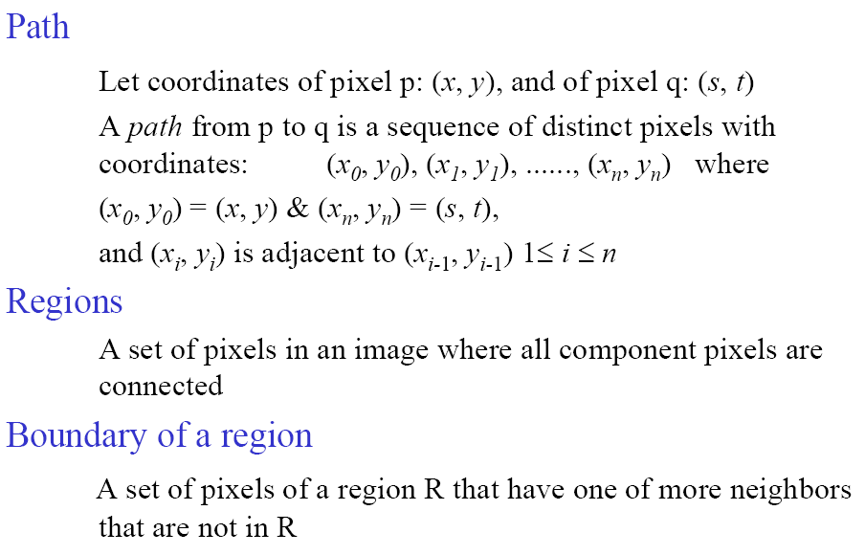
Basic Relationship b/w Pixels
8

Slide 9
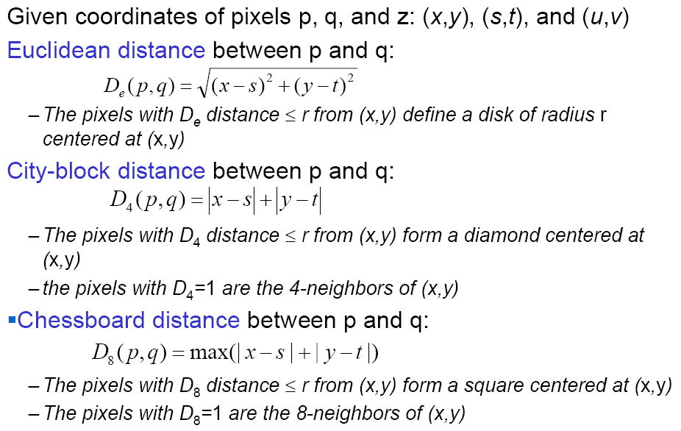
Basic Relationship b/w Pixels
9

Slide 10
A Note About Grey Levels
So far when we have spoken about image grey level values we have said they are in the range [0, 255]
Where 0 is black and 255 is white
There is no reason why we have to use this range
The range [0,255] stems from display technologes
For many of the image processing operations in this lecture grey levels are assumed to be given in the range [0.0, 1.0]
Notes:
10

Slide 11
What Is Image Enhancement?
Image enhancement is the process of making images more useful
The reasons for doing this include:
Highlighting interesting detail in images
Removing noise from images
Making images more visually appealing
Notes:
11

Slide 12
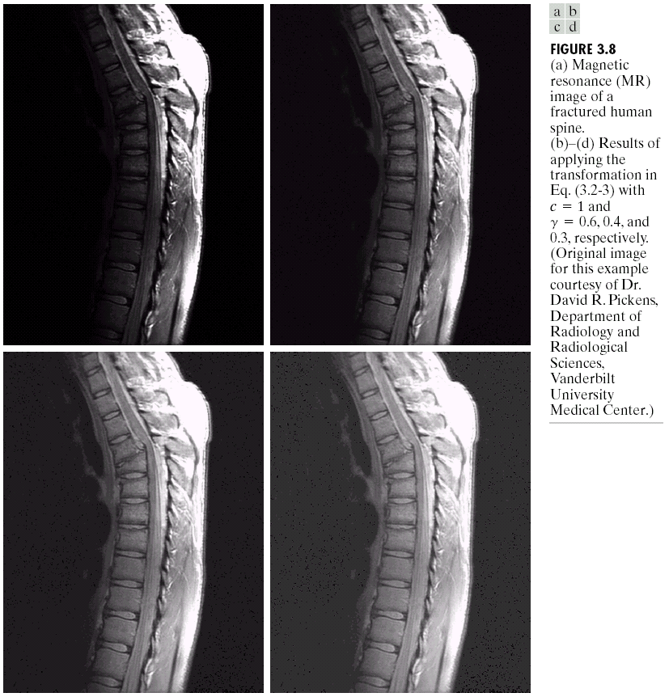
Image Enhancement Examples
Notes:
12

Slide 13
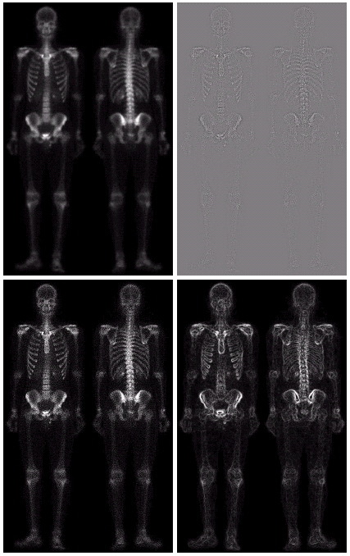
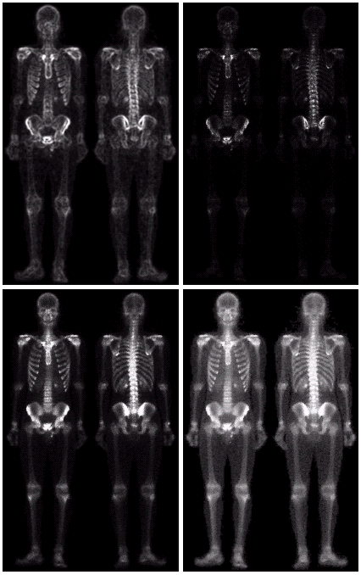
Image Enhancement Examples (cont…)
Notes:
13

Slide 14
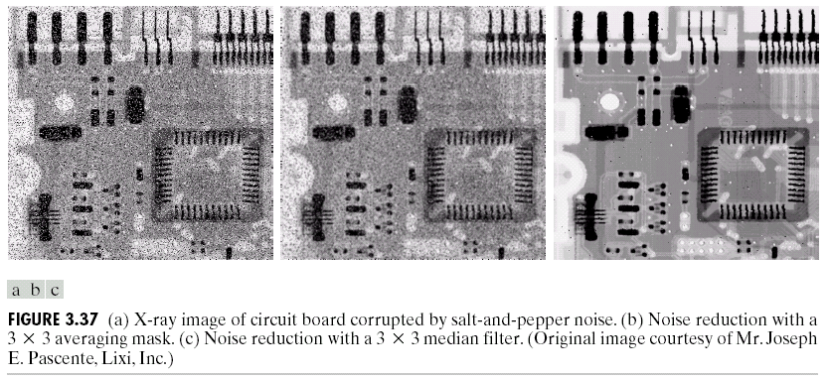
Image Enhancement Examples (cont…)
Notes:
14

Slide 15
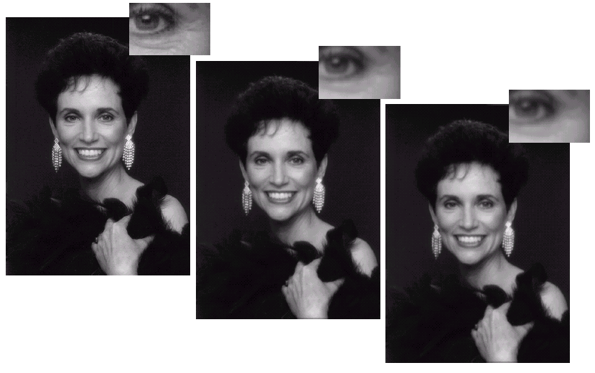
Image Enhancement Examples (cont…)
Notes:
15

Slide 16
Spatial & Frequency Domains
There are two broad categories of image enhancement techniques
Spatial domain techniques
Direct manipulation of image pixels
Frequency domain techniques
Manipulation of Fourier transform or wavelet transform of an image
For the moment we will concentrate on techniques that operate in the spatial domain
Notes:
16

Slide 17
Image Engancement
Process an image to make the result more suitable than the original image for a specific application
–Image enhancement is subjective (problem /application oriented)
Image enhancement methods:
Spatial domain: Direct manipulation of pixel in an image (on the image plane)
Frequency domain: Processing the image based on modifying the Fourier transform of an image
Many techniques are based on various combinations of methods from these two categories

Slide 18
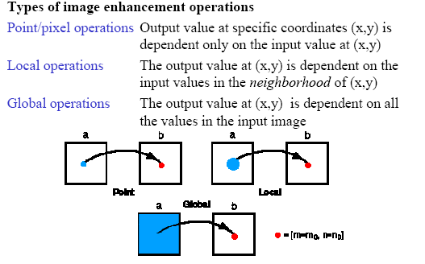
Image Enhancement
18

Slide 19
Some Basic Concepts
Spatial domain enhancement methods can be generalized as
g(x,y)=T[f(x,y)]
f(x,y): input image
g(x,y): processed (output) image
T[*]: an operator on f (or a set of input images), defined over neighborhood of (x,y)
Neighborhood about (x,y): a square or rectangular sub-image area centered at (x,y)
19

Slide 20
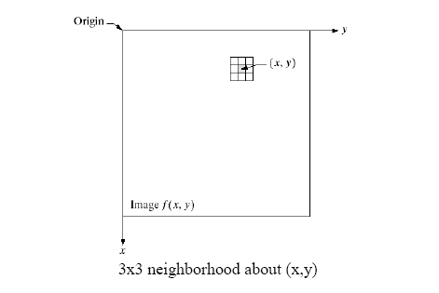
Some Basic Concepts
20

Slide 21
Some Basic Concepts
g(x,y) = T [f(x,y)]
Pixel/point operation:
Neighborhood of size 1x1: g depends only on f at (x,y)
T: a gray-level/intensity transformation/mapping function
Let r = f(x,y) s = g(x,y)
r and s represent gray levels of f and g at (x,y)
Then s = T(r)
Local operations:
g depends on the predefined number of neighbors of f at (x,y)
Implemented by using mask processing or filtering
Masks (filters, windows, kernels, templates) :
a small (e.g. 3×3) 2-D array, in which the values of the
coefficients determine the nature of the process

Slide 22
Point Processing
The simplest spatial domain operations occur when the neighbourhood is simply the pixel itself
In this case T is referred to as a grey level transformation function or a point processing operation
Point processing operations take the form
s = T ( r )
where s refers to the processed image pixel value and r refers to the original image pixel value
Notes:
22

Slide 23
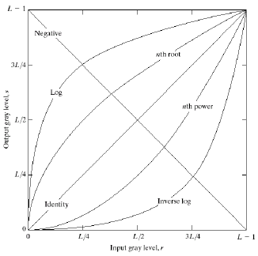
Common Pixel Operations
Image Negatives
Log Transformations
Power-Law Transformations
23

Slide 24
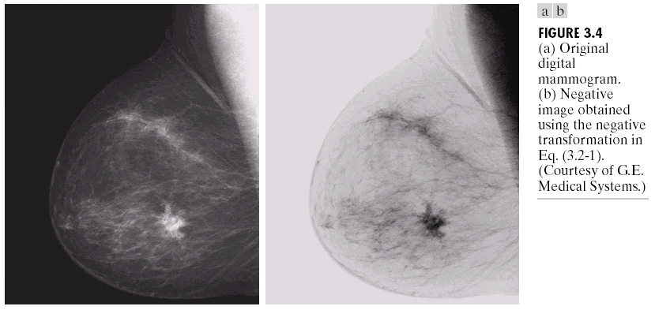
Point Processing Example: Negative Images
Negative images are useful for enhancing white or grey detail embedded in dark regions of an image
Note how much clearer the tissue is in the negative image of the mammogram below
Original Image
Negative Image
Notes:
24

Slide 25
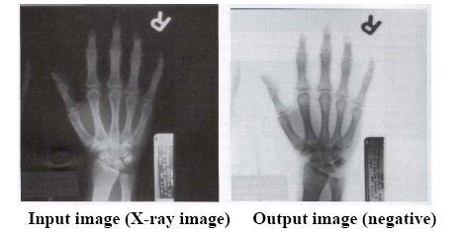
Negative Images

Slide 26
Point Processing Example: Negative Images (cont…)
Original Image
x
Enhanced Image
x
y
Image f (x, y)
y
Image f (x, y)
s = intensity_{max} - r
For L gray levels the transformation function is
s =T(r) = (L - 1) - r
Notes:
26

Slide 27
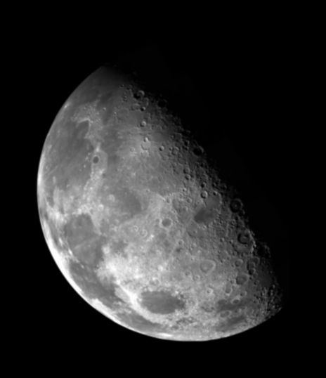

Point Processing Example: Thresholding
Thresholding transformations are particularly useful for segmentation in which we want to isolate an object of interest from a background
255
r > threshold
s =
0
r <= threshold
Notes:
27

Slide 28
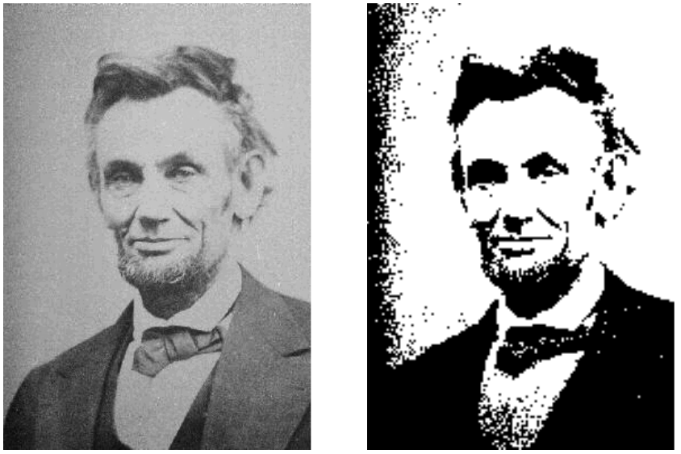
Point Processing Example: Thresholding

Slide 29
Point Processing Example: Thresholding (cont…)
Original Image
x
Enhanced Image
x
y
Image f (x, y)
y
Image f (x, y)
255 r > threshold
s =
0 r <= threshold
Notes:
29

Slide 30
Intensity Transformations

Slide 31
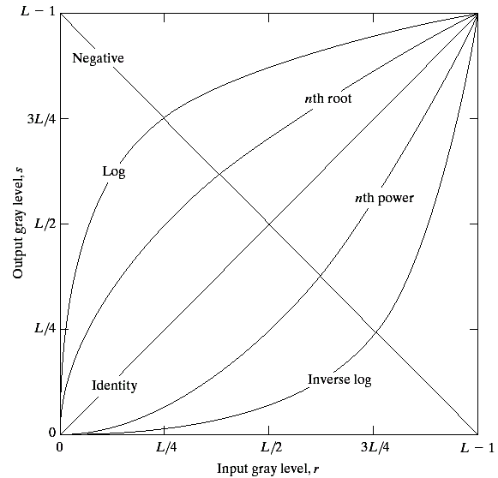
Basic Grey Level Transformations
There are many different kinds of grey level transformations
Three of the most common are shown here
Linear
Negative/Identity
Logarithmic
Log/Inverse log
Power law
n^{th} power/n^{th} root
Notes:
31

Slide 32
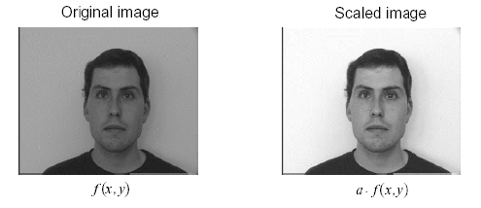
Image Scaling
s =T(r) = a.r (a is a constant)

Slide 33
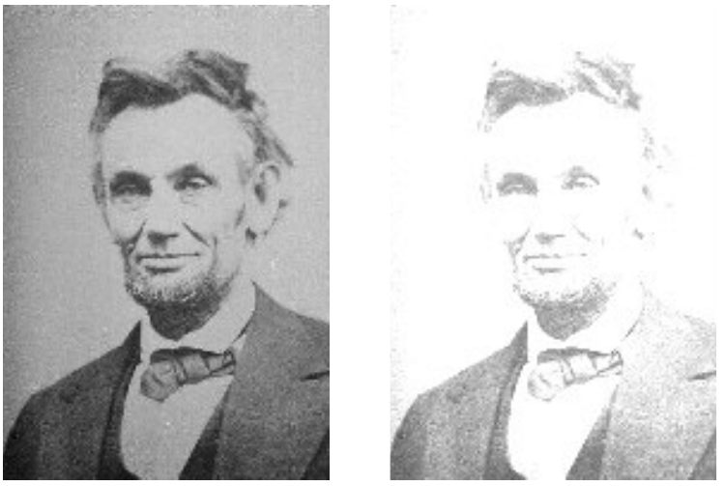
Image Scaling

Slide 34
Logarithmic Transformations
The general form of the log transformation is
s = c * log(1 + r)
The log transformation maps a narrow range of low input grey level values into a wider range of output values
The inverse log transformation performs the opposite transformation
Log functions are particularly useful when the input grey level values may have an extremely large range of values
Notes:
34

Slide 35
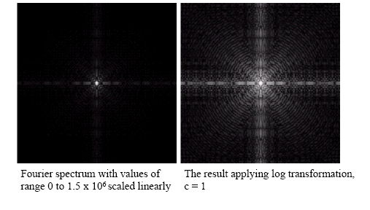
Logarithmic Transformations (cont…)

Slide 36
Logarithmic Transformations
Properties of log transformations
–For lower amplitudes of input image the range of gray levels is expanded
–For higher amplitudes of input image the range of gray levels is compressed
Application:
This transformation is suitable for the case when the dynamic range of a processed image far exceeds the capability of the display device (e.g. display of the Fourier spectrum of an image)
Also called “dynamic-range compression / expansion”
36
08/01/2018

Slide 37
Logarithmic Transformations (cont…)
Original Image
x
Enhanced Image
x
y
Image f (x, y)
y
Image f (x, y)
s = log(1 + r)
We usually set c to 1
Grey levels must be in the range [0.0, 1.0]
Notes:
37

Slide 38
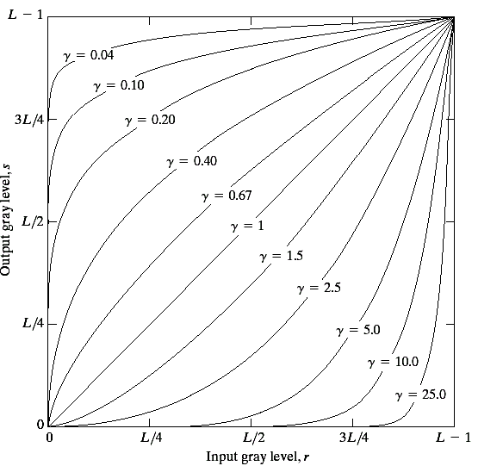
Power Law Transformations
Power law transformations have the following form
s = c * r ^{γ}
c & γ must be positive
Map a narrow range of dark input values into a wider range of output values or vice versa
Varying γ gives a whole family of curves
Notes:
38

Slide 39
Power Law Transformations (cont…)
Original Image
x
Enhanced Image
x
y
Image f (x, y)
y
Image f (x, y)
s = r ^{γ}
We usually set c to 1
Grey levels must be in the range [0.0, 1.0]
Notes:
39

Slide 40
Power Law Transformations (cont…)
For γ < 1: Expands values of dark pixels, compress values of brighter pixels
For γ > 1: Compresses values of dark pixels, expand values of brighter pixels
If γ=1 & c=1: Identity transformation (s = r)
A variety of devices (image capture, printing, display) respond according to power law and need to be corrected
Gamma (γ) correction
The process used to correct the power-law response phenomena

Slide 41
Power Law Example
Notes:
41

Slide 42
Power Law Example (cont…)
γ = 0.6
Notes:
42

Slide 43
Power Law Example (cont…)
γ = 0.4
Notes:
43

Slide 44
Power Law Example (cont…)
γ = 0.3
Notes:
44

Slide 45
Power Law Example (cont…)
The images to the right show a magnetic resonance (MR) image of a fractured human spine
Different curves highlight different detail
Notes:
45
The third transform is a step too far

Slide 46
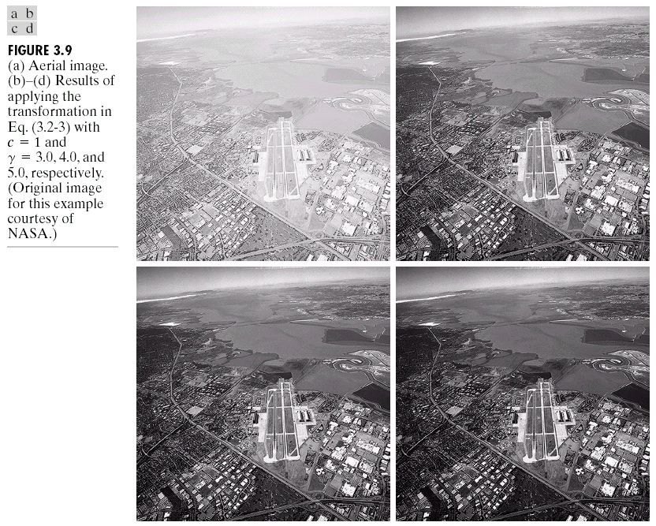
Power Law Example
γ = 1.0
Notes:
46

Slide 47
Power Law Example (cont…)
γ = 3.0

Slide 48
Power Law Example (cont…)
γ = 4.0

Slide 49
Power Law Example (cont…)
γ = 5.0
Notes:
49

Slide 50
Power Law Transformations (cont…)
An aerial photo of a runway is shown
This time power law transforms are used to darken the image
Different curves highlight different detail
Notes:
50

Slide 51
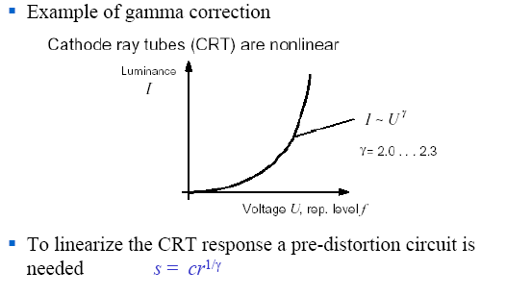
Power Law Transformations (cont…)
51

Slide 52
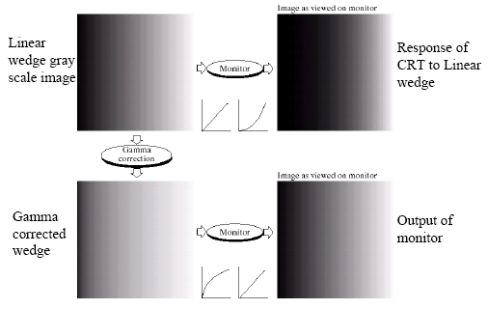
Gamma Correction
Problem: CRT display devices do not respond linearly to different intensities

Slide 53
More Contrast Issues

Slide 54
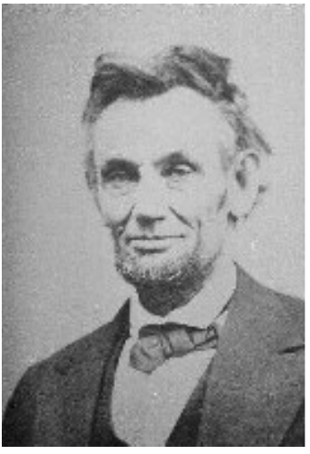
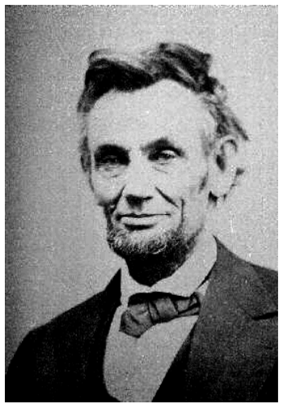
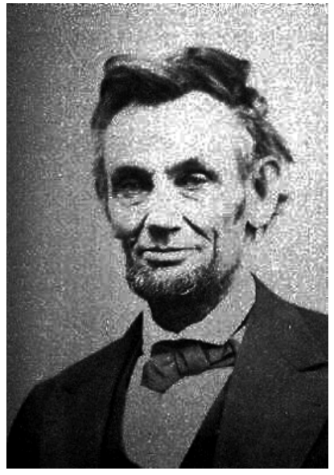
More Contrast Issues

Slide 55
Piecewise Linear Transformation
Contrast Stretching
Goal:
Increase the dynamic range of the gray levels for low contrast images
Low-contrast images can result from
–poor illumination
–lack of dynamic range in the imaging sensor
–wrong setting of a lens aperture during image acquisition
Notes:
55

Slide 56
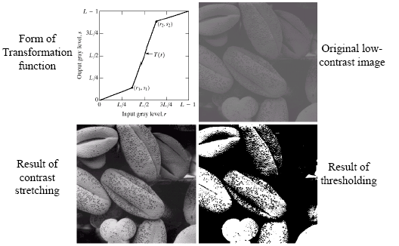
Contrast Stretching

Slide 57
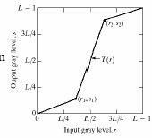
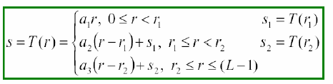
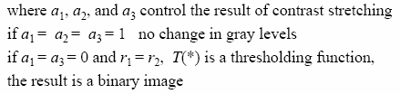
Contrast Stretching
57

Slide 58
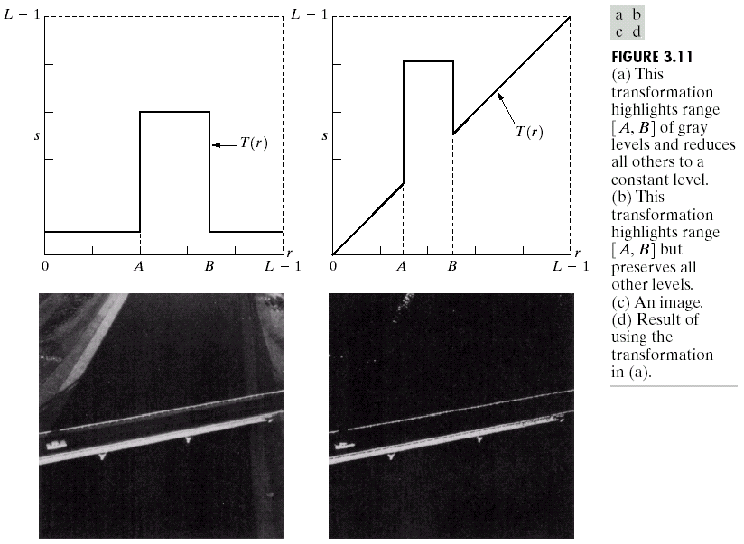
Gray Level Slicing
Highlights a specific range of grey levels
Similar to thresholding
Other levels can be suppressed or maintained
Useful for highlighting features in an image
Notes:
58

Slide 59
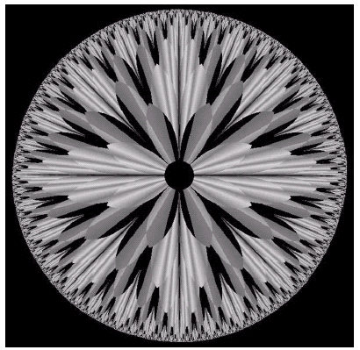
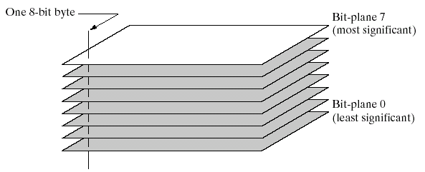
Bit Plane Slicing
Often by isolating particular bits of the pixel values in an image we can highlight interesting aspects of that image
Higher-order bits usually contain most of the significant visual information
Lower-order bits contain subtle details
Notes:
59

Slide 60
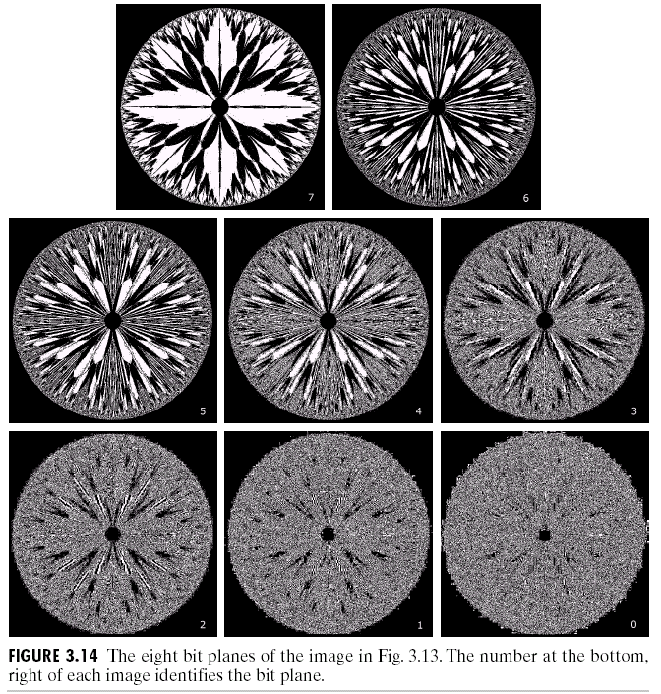
Bit Plane Slicing (cont…)
[10000000]
[01000000]
[00100000]
[00001000]
[00000100]
[00000001]
Notes:
60

Slide 61
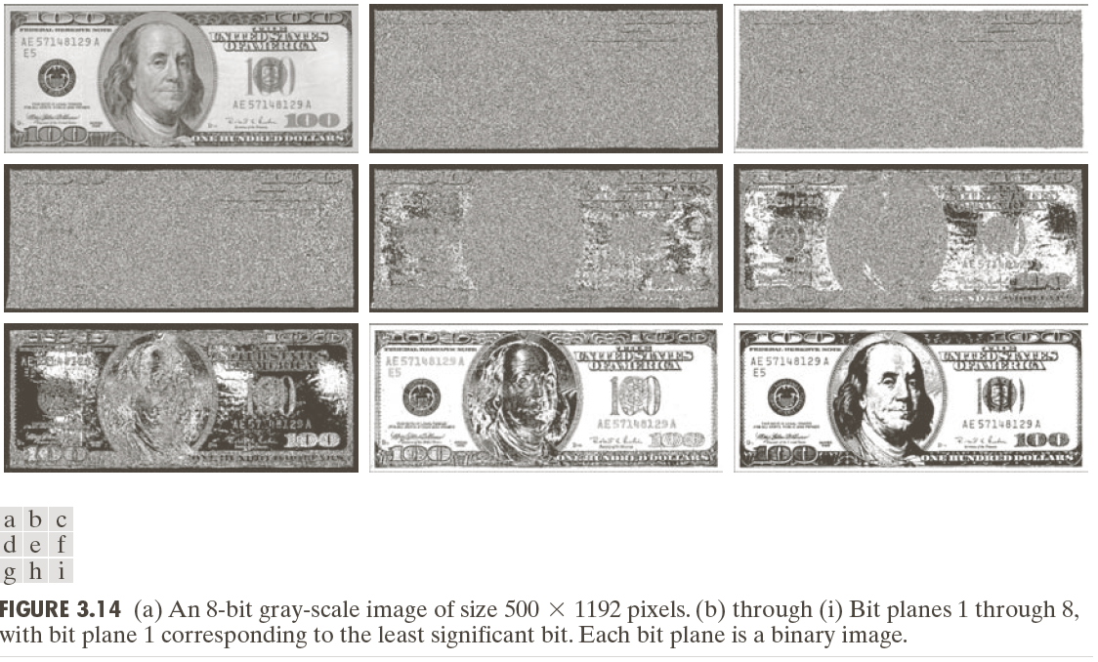
Bit Plane Slicing (cont…)
Notes:
61

Slide 62
Bit Plane Slicing (cont…)
Notes:
62

Slide 63
Bit Plane Slicing (cont…)
Notes:
63

Slide 64
Bit Plane Slicing (cont…)
Notes:
64

Slide 65
Bit Plane Slicing (cont…)
Notes:
65

Slide 66
Bit Plane Slicing (cont…)
Notes:
66

Slide 67
Bit Plane Slicing (cont…)
Notes:
67

Slide 68
Bit Plane Slicing (cont…)
Notes:
68

Slide 69
Bit Plane Slicing (cont…)
Notes:
69

Slide 70
Bit Plane Slicing (cont…)
Notes:
70

Slide 71
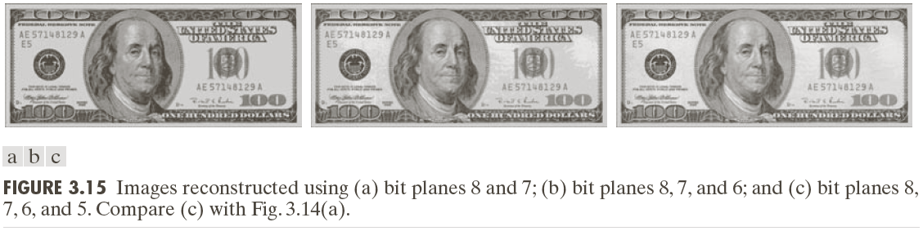
Bit Plane Slicing (cont…)
Reconstructed image using only bit planes 8 and 7
Reconstructed image using only bit planes 8, 7 and 6
Reconstructed image using only bit planes 7, 6 and 5
Notes:
71

Slide 72
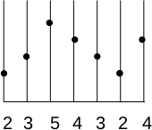
A Different Problem

Slide 73
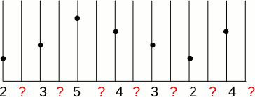
Lets Double the Size

Slide 74
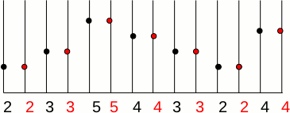
Interpolation
Nearest Neighbor

Slide 75
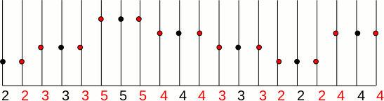
What Happens When Tripling

Slide 76
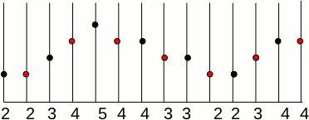
Is There a Better Method
Interpolation: Bi-Linear

Slide 77
Is There be a Better Method

Slide 78
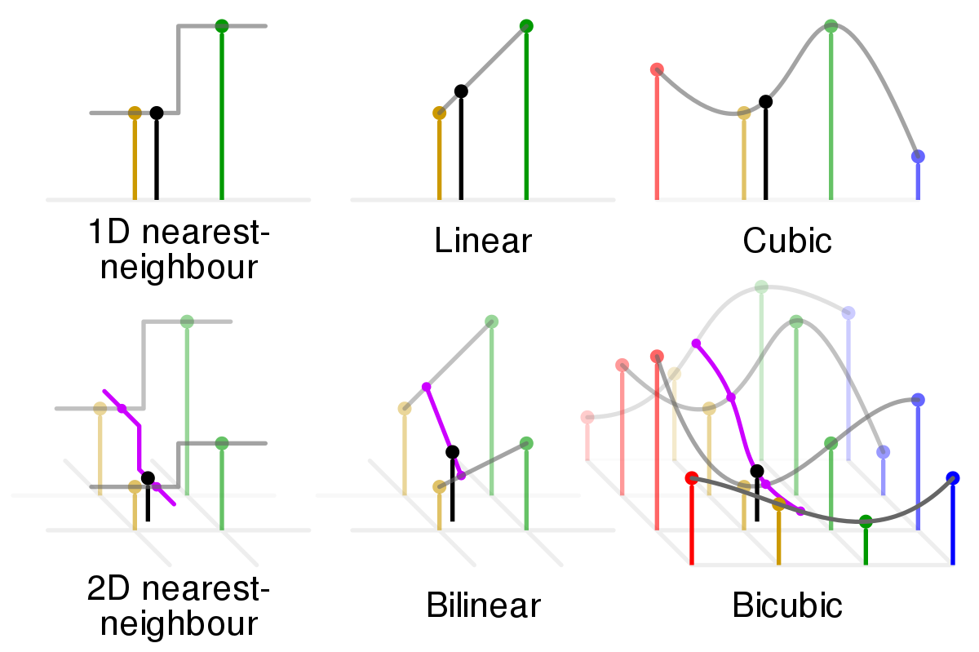
What Happens in 2D

Slide 79
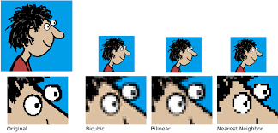
Which is Better

Slide 80




Which is Better
Lets Scale
Before Interpolation
Original
Nearest Neighbor
Bi-Linear

Slide 81
No Interpolation
Interpolated
Fast as No Processing Required
Depends on only 2 Pixel
Results are Blocky
Cannot Create New Values
Not Recommended for Smooth Data
New Value always inside the boundary range
Slow due to Processing
Depends on 4 or more pixels
Smoother Gradients
Can Find New Values
Not Recommended for Categorical Data
Value may or May not be outside the boundary range

Slide 82
Summary
We have looked at different kinds of point processing image enhancement
Assignment & Quiz
Bring Your Laptops on Monday?
Next time we will start to look at Global Operations
Notes:
82

